Slide 1
Network Security Project
IDENTIFYING VULNERABILITIES
BY: Y@h@ck5 +2348140879281

Slide 2
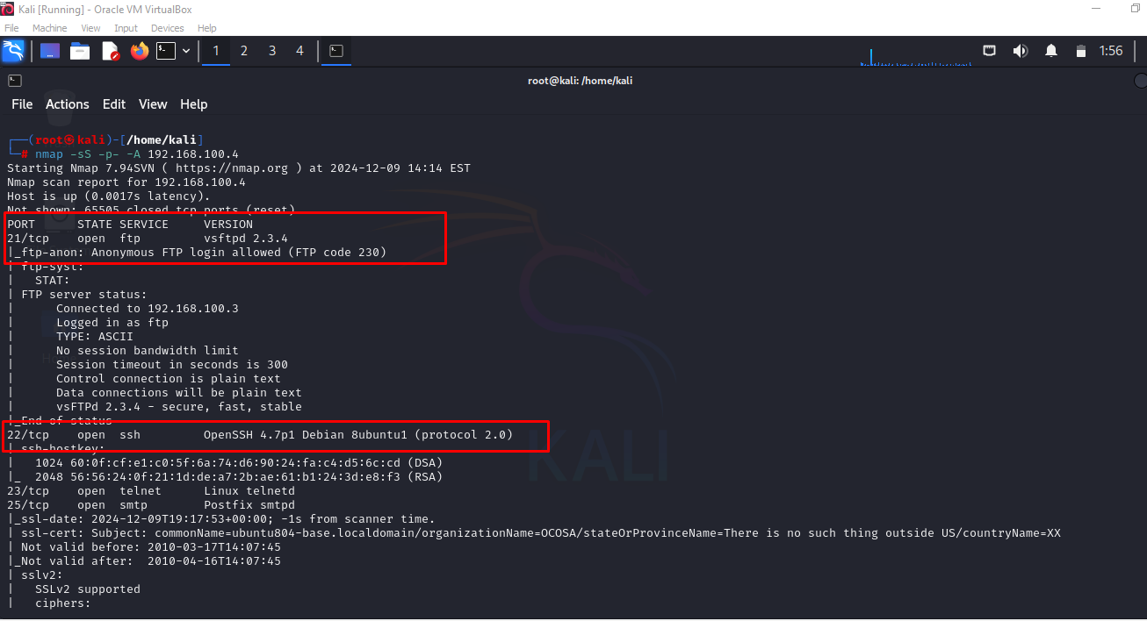
Scanning the Server using Nmap
Use the following nmap command: nmap -sS -p- -A 192.168.100.4 to scan the server(Metasploitable2) from the client(Kali).
The scan result shows several open ports such as, 80, 22, 21.
Noticed the version for each ports are listed E.g vsftpd 2.3.4

Slide 3
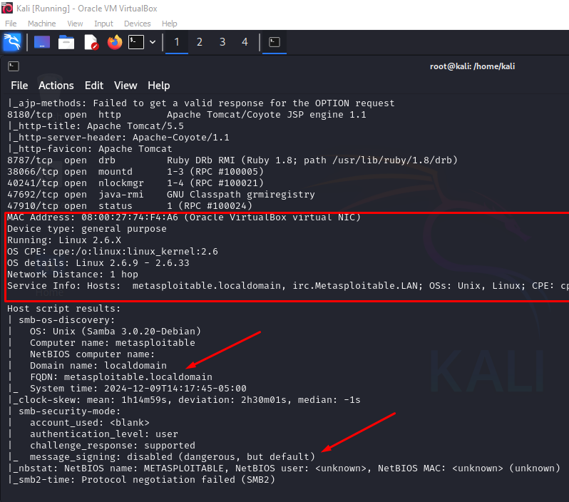
Analyzing the Scan Result
From the scan result in the previous slide, I noticed several information were exposed from the server. I further analyze the scan to find the netbios informion such as. names and user. I also noticed the OS information displayed as seen in the image.

Slide 4
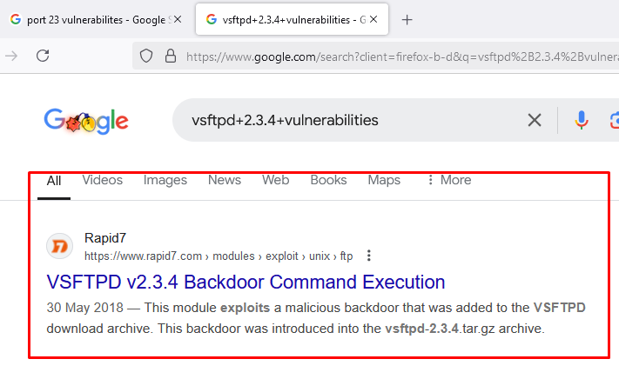
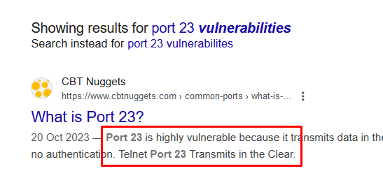
Identify Vulnerabilties
In the scan result we noticed a vulnerable port 23 is open and runs Telnet service which sends communications in clear text.
Futher investigation on the ftp version indicates a critical vulnerability which need a quick fix.

Slide 5
THANKS
NEXT:CONFIGURE A FIREWALL

